Slide 1

Rajeswari Vedachalam Government Arts college Chengalpattu
PG Department of B.sc Computer Science

Slide 2
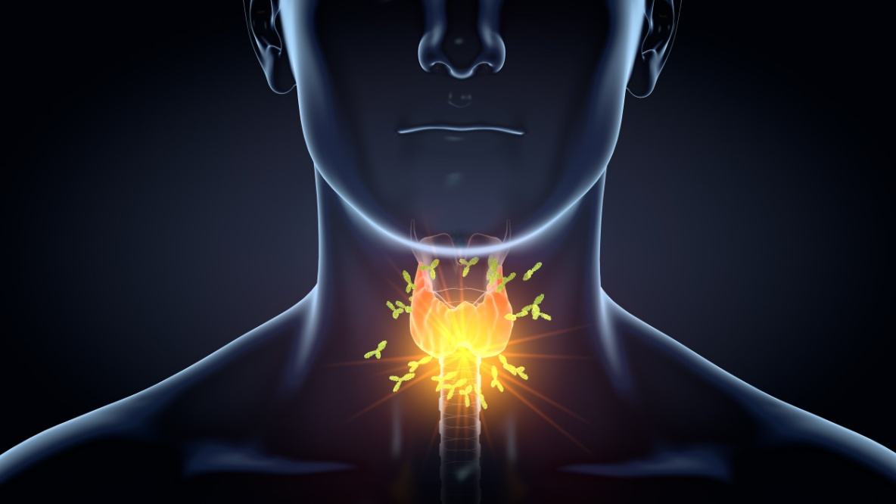
THYROID DISEASE CLASSIFICATION
TEAM MEMBERS:
1.E.Sathyapriya
2.S.Sharmiladevi
3.M.Nivetha
4.J.Narmatha

Slide 3
INTRODUCTION
Thyroid diseases are increasing in magnitude everyday and spreading all over the world.
The thyroid gland is a vascular and one of the most important organs of the humans body.
Thyroid gland secrets two harmones which helps in controlling the metabolism of the body.
Normal thyroid stimulating hormone levels generally fall between o.4 and 4.0 milliunits per liter. Tsh levels higher than 4. mU/L usually indicate an underactive thyroid (hypothyroidism), and low TSH levels below 0.4 mU/L indicate an overactive thyroid (hyperthyroidism).

Slide 4
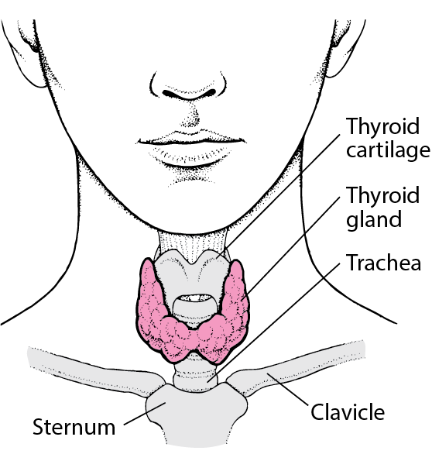
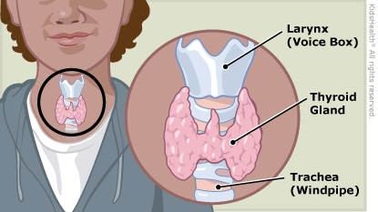
Types of Thyroid Disorders:
Two Types of Thyroid Disorders
Two types of thyroid disorders
Hyperthyroidism
Hypothyroidism

Slide 5
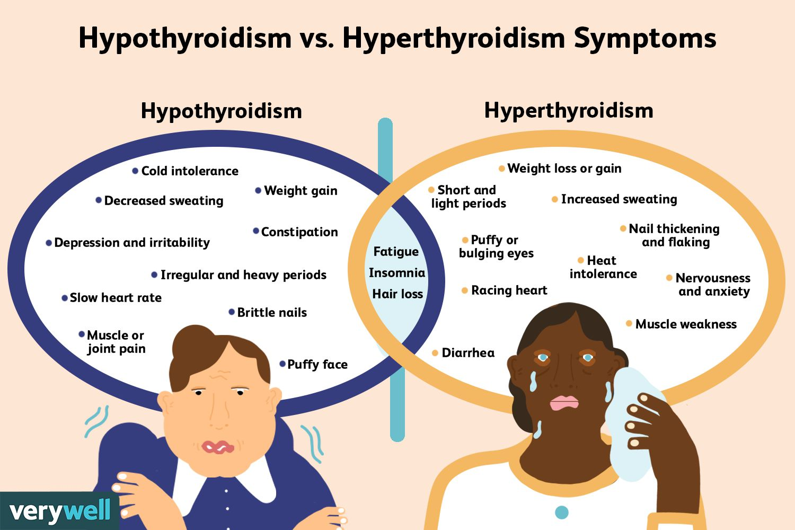
Hypothyroism vs Hyperthyroism Symptoms:

Slide 6
Project Structure:
Download the Dataset.
https://www.kaggle.com/prathamtripathi/drug-classification.
2. Read the Dataset
Data Collection And Preparation
Checking for null values .
Splitting the Data X and Y.
Converting the data type.
Splitting data into train and test.
Handling Imbalanced Data.
Data Pre processing
Descriptive Data Analysis
Visual Data Analysis
Exploratory Data Analysis
Model Building
Training the model in Multiple Algorithms like Random classifier, K-NN classification.

Slide 7
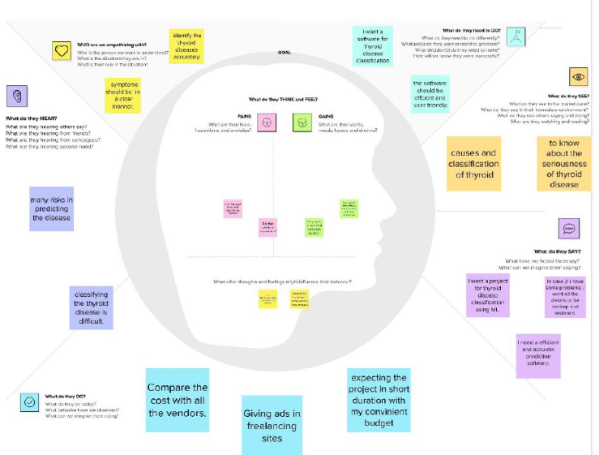
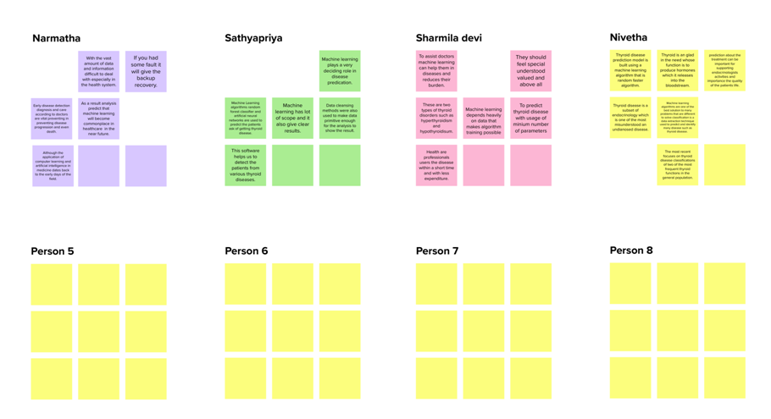
METHODOLOGY
Machine learning models are powerful use to efficiently and effectively perform vital tasks and solve complex probems.
M.L plays a deciding role in predicting the accurate result.
Empathy map canvas and Brainstroming are done in mural.
Mural enhances the ability to create a safe to colloborate and contribute and lead to more innovative, impactful solutions.
Empathy Map Canvas
Brain Strom

Slide 8
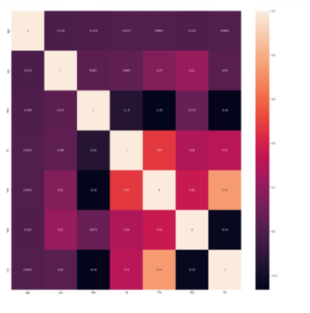
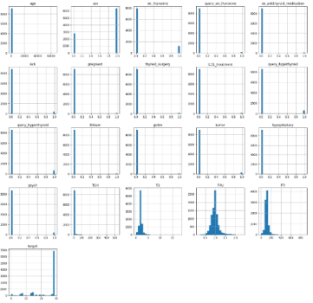
Exploratory Data Analysis:
Exploratory Data Analysis is an approach to analyze the data using visual techniques. It is used to discover trends, patterns, or to check assumptions with the help of statistical summary and graphical representations.
A heat map is data anlysis software that uses color the way a bar uses height an with.
Heat map
Histogram repreent the frequency distribution of the data
Histogram

Slide 9
Classification Techniques:
1.Decision Tree Classification.
2.Random Forest Classification.
3.K-NN Classification.
4.SVM Classification.
5.logistic Regression Classification.

Slide 10
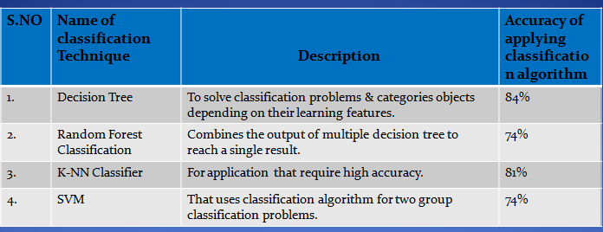
Model Implementation:
Now we can conclude that decision tree provides a accurate results of 84%.
We can use decision tree to get better result you can get some insights by above methods.

Slide 11
Conclusion:
To assist doctors machine learning help them in diaponasis of disease and reduces their burden.
The feature set finally used is ‘Age’, ‘Sex’, ‘TSH’, ‘TT4’, ‘T4U’, ‘T3’, ‘FTI’. Age and Sex have been considered as important features because Thyroid disorders are said to occur during a particular age and most particularly in females.
2 classes of Thyroid disorders namely Hyperthyroid,Hypothyroidcan be classified.
Health care professionals to cures the disease with in a short time and with less expenditure.

Slide 12
References:
Alyas, Tahir, et al. "Empirical method for thyroid disease classification using a machine learning approach." BioMed Research International 2022 (2022).
Moon, Jae Hoon, and Steven R. Steinhubl. "Digital medicine in thyroidology: a new era of managing thyroid disease." Endocrinology and Metabolism 34.2 (2019): 124-131.
Razia, Shaik, P. Siva Kumar, and A. Srinivasa Rao. "Machine learning techniques for thyroid disease diagnosis: a systematic review." Modern Approaches in Machine Learning and Cognitive Science: A Walkthrough: Latest Trends in AI (2020): 203-212.
Asif, Md Asfi-Ar-Raihan, et al. "Computer aided diagnosis of thyroid disease using machine learning algorithms." 2020 11th International Conference on Electrical and Computer Engineering (ICECE). IEEE, 2020.
Turken, Orhan, et al. "Breast cancer in association with thyroid disorders." Breast Cancer Research 5.5 (2003): 1-4.

Slide 13


